Slide 1
3 small CPU tips:
endianness, byte-alignment and stack growth
Xiao, Nan

Slide 2
About Myself
A system software / performance engineer;
Like diving into technologies related to computer infrastructure, such as Operating System kernel, concurrent programming, debugging, performance tuning;
Non-native English speaker, and sorry for my poor oral speaking.

Slide 3
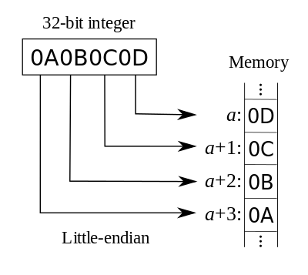
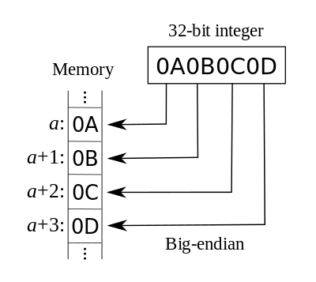
Endianness
The CPU has 2 kind of endianness (The images are from Wikipedia).
Little-Endian(E.g., X86)
Big-Endian (E.g., SPARC)

Slide 4
Byte-Alignment
Some CPUs require strict byte-alignment (Mostly many RISC architectures, e.g., SPARC), i.e., the begin memory address of short (size is 2 bytes) data should be multiple of 2 (0x0), while integer (size is 4 bytes) should multiple of 4 (0x00), etc. If the data is not byte-alignment, the program will crash. For example, on SPARC, it will complain “Bus error”.
Some CPUS doesn’t require strict byte-alignment, e.g., X86.

Slide 5
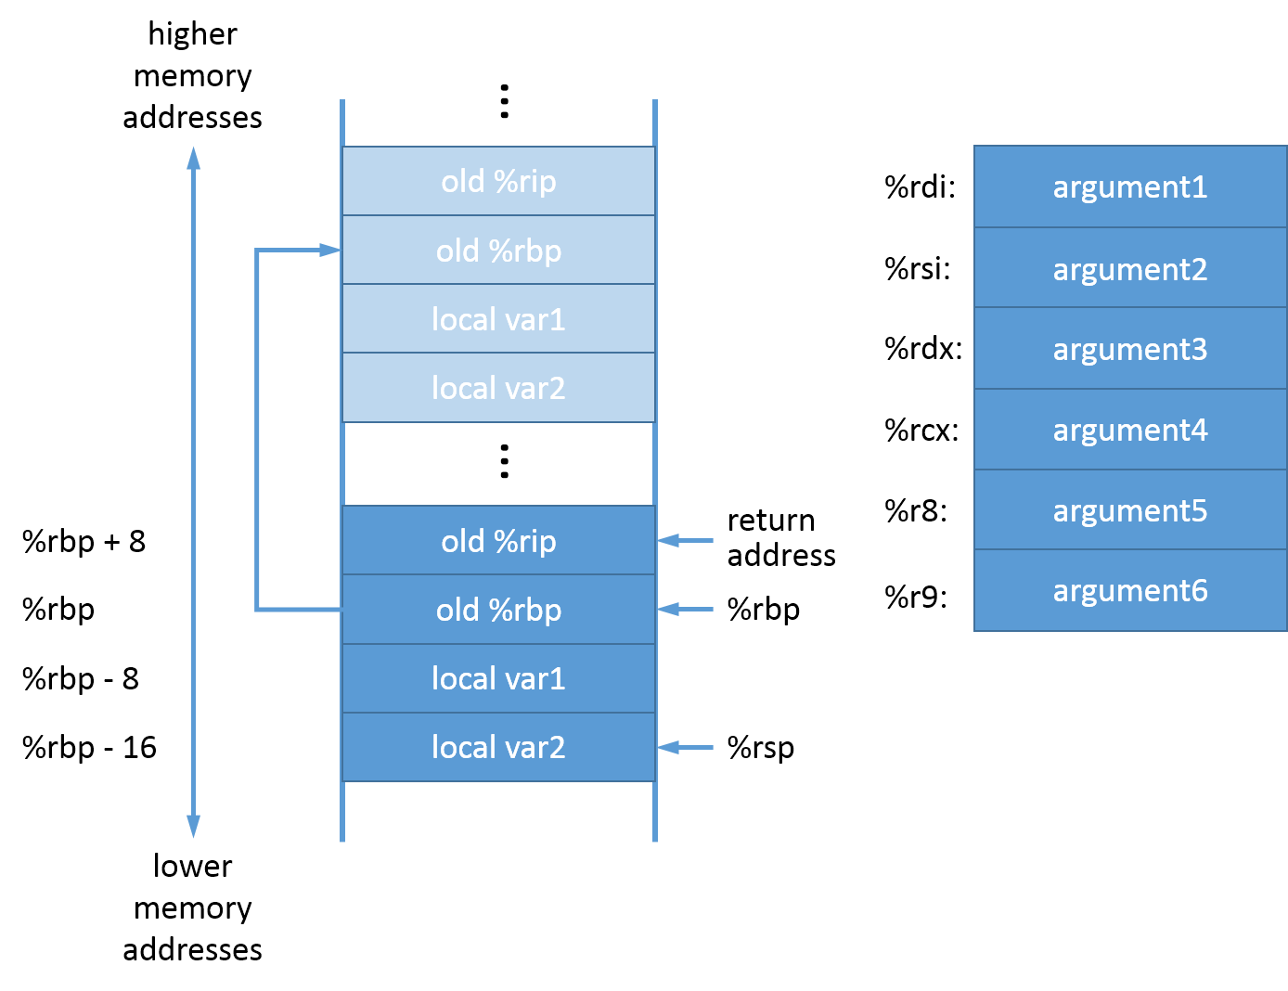
Stack Growth
Most CPUs' stack growth is from higher address to lower. Take X86_64 architecture as an example (image is from here):

Slide 6
End
The material is https://github.com/NanXiao/cpu-tips.
Thanks!
Q &A

